Slide 1
Introduction to HCI

Slide 2
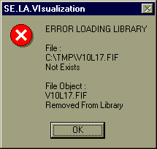
Intro
What is a user interface?
Why do we care about design?
We see this all the time.
What’s good about the design of this error box?
The user knows there is an error
What’s poor about the design of this error box?
Discouraging
Not enough information
No way to resolve the problem (instructions or contact info)

Slide 3
Definition of HCI
Human-computer interaction is a discipline concerned with the design, evaluation and implementation of interactive computing systems for human use and with the study of major phenomena surrounding them.
ACM SIGCHI Curricula for HCI (Hewett et al. 1992)
http://sigchi.org/cdg/cdg2.html

Slide 4
Why HCI is Important
The study of our interface with information.
It is not just ‘how big should I make buttons’ or ‘how to layout menu choices’
It can affect
Effectiveness
Productivity
Morale
Safety
Example: a car with poor HCI
Take 5 minutes for everyone to write down one common device with substantial HCI design choices and discuss with the neighbor the pros and cons. How does it affect you or other users?

Slide 5
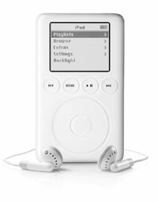
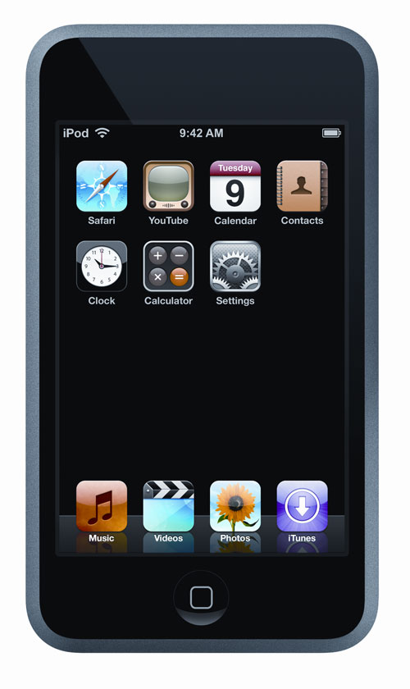
My Choice
iPod by Apple Computers
Pros:
portable
power
ease of use
# of controls
Cons:
scratches easily
no speech for car use
proprietary

Slide 6
What fields does HCI cover?
Computer Science
Psychology (cognitive)
Communication
Education
Anthropology
Design (e.g. graphic and industrial)

Slide 7
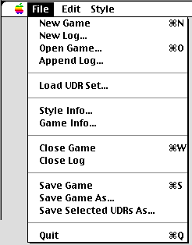
HCI Community
Academics/Industry Research
Taxonomies
Theories
Predictive models
Experimenters
Empirical data
Product design
Other areas (Sociologists, anthropologists, managers)
Motor
Perceptual
Cognitive
Social, economic, ethics

Slide 8
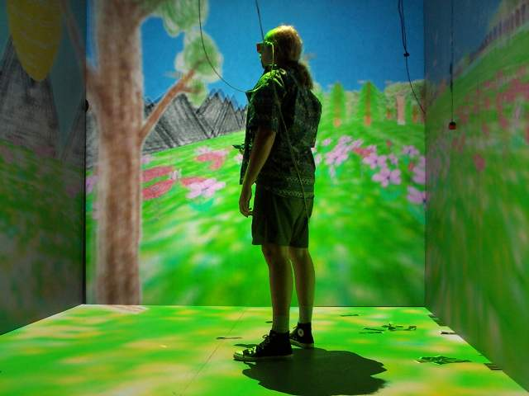
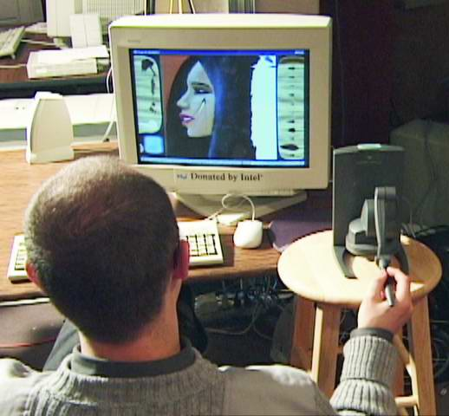
HCI Tools
Sound
3D
Animation
Video
Devices
Size (small->very large)
Portable (PDA, phone)
Plasticity
Context sensitive/aware
Personalizable
Ubiquitous

Slide 9
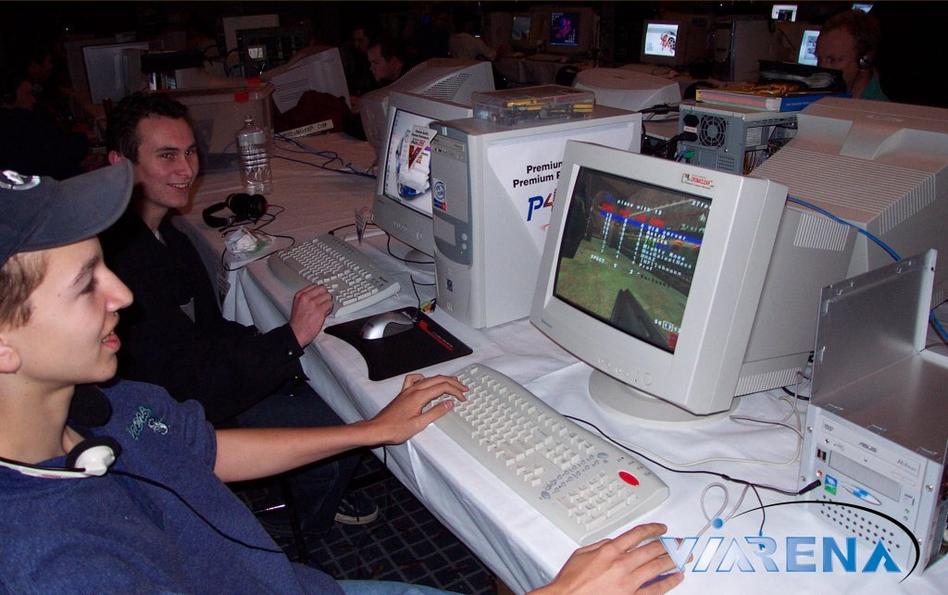
Usability Requirements
Goals:
Usability
Universality
Usefulness
Achieved by:
Planning
Sensitivity to user needs
Devotion to requirements analysis
Testing

Slide 10
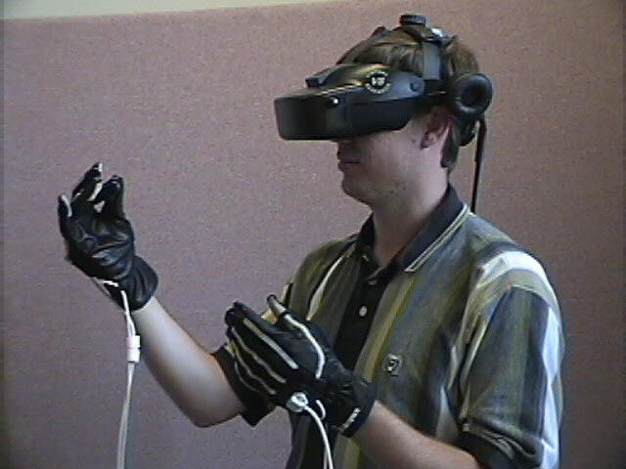
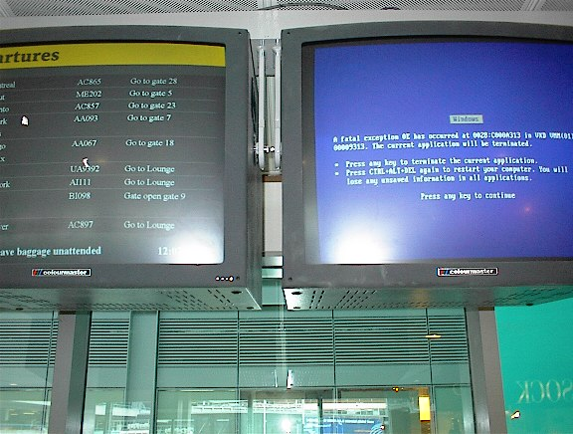
Bad Interfaces
Encumbering
Confusing
Slow
Trust (ex. windows crashing)
What makes it hard?
Varies by culture
Multiple platforms
Variety of users

Slide 11

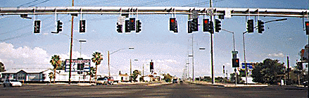
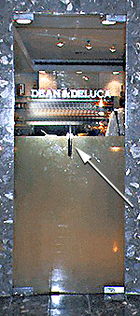
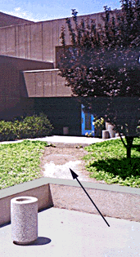

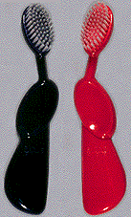

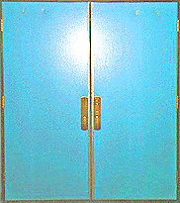
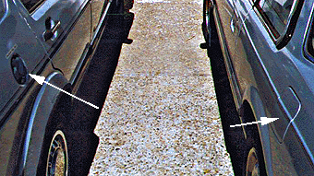
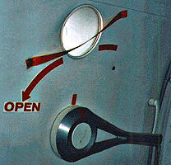
What’s wrong with each?
Type of error
Who is affected
Impact
What’s a redesign solution?

Slide 12
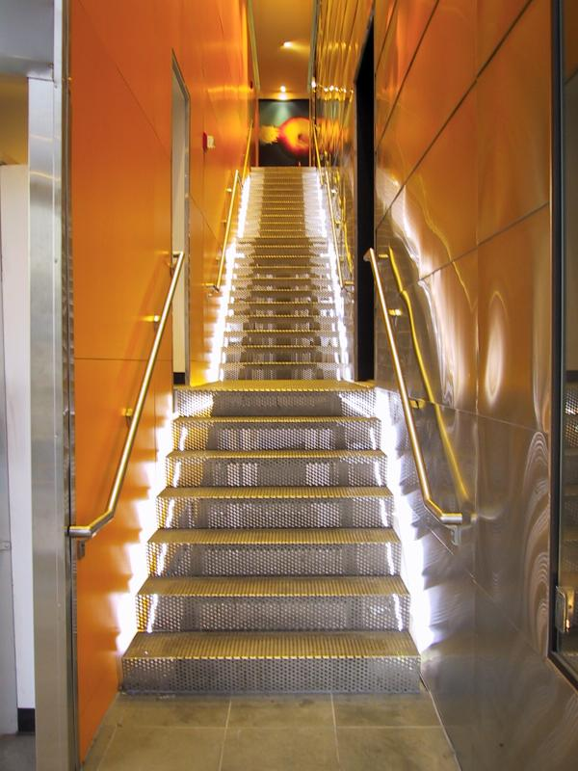
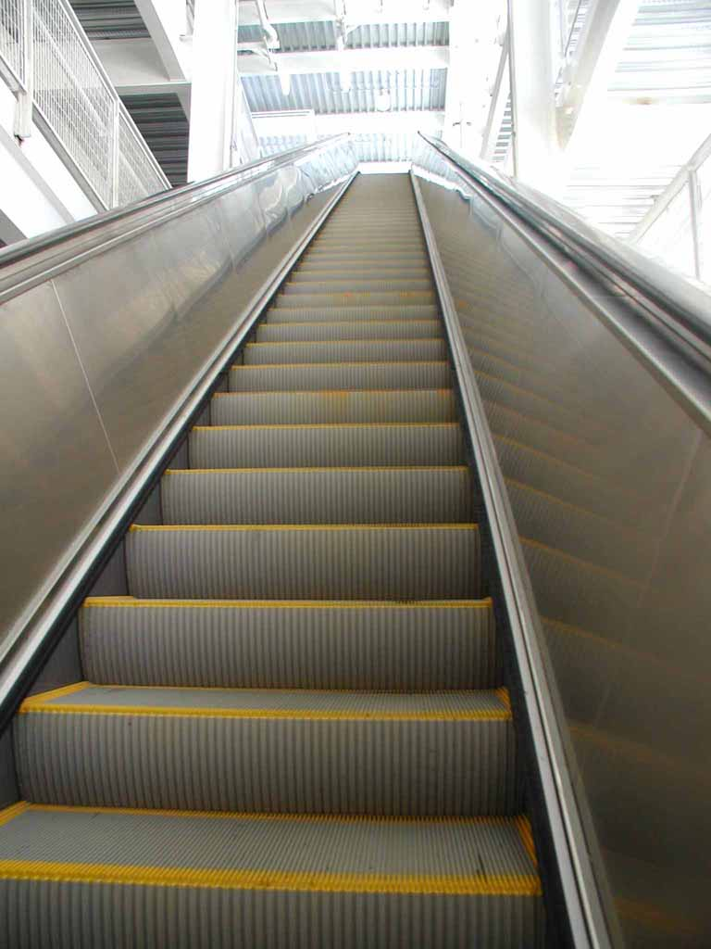
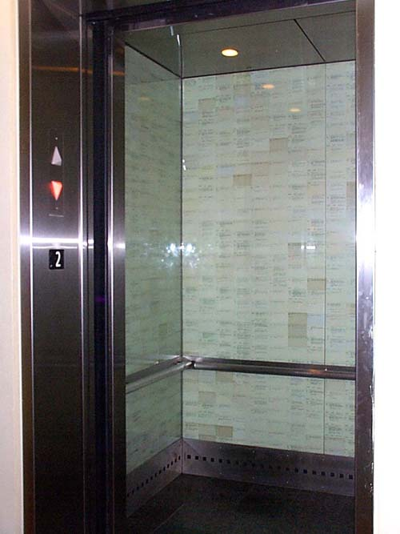
Requirements Analysis
Ascertain users’ needs
Ensure proper reliability
Promote appropriate standardization, integration, consistency, and portability
Complete projects on schedule and within budget

Slide 13
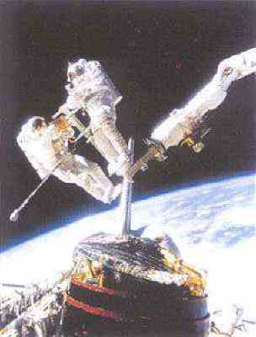
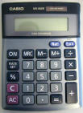
Ascertain User’s Needs
Define tasks
Tasks
Subtasks
Frequency
Frequent
Occasional
Exceptional
Repair
Ex. difference between a space satellite, car engine, and fighter jet

Slide 14
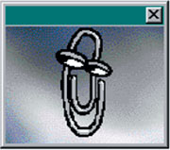
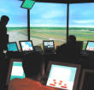
Reliability
Actions function as specified
Data displayed must be correct
Updates done correctly
Leads to trust! (software, hardware, information) – case: Pentium floating point bug
Privacy, security, access, data destruction, tampering

Slide 15
Standardization, Integration, Consistency, Portability
Standardization – common user-interface features across multiple applications
Apple
Web
Windows
Integration – across application packages
file formats
Consistency – common action sequences, terms, units, layouts, color, typography within an application
Portability – convert data and interfaces across multiple hardware and software environments
Word/HTML/PDF/ASCII

Slide 16
Case Study: Library of Congress Database Design
http://catalog.loc.gov/
Two interfaces
Catalog New Books
3-6 hour training course - staffers
Search Catalog of Books
General public – too complex, command language and complex cataloging rules
Solution
Touch screen
Reduced functionality
Better information presentation
Eventually Web based interface
Same database and services, different interfaces

Slide 17

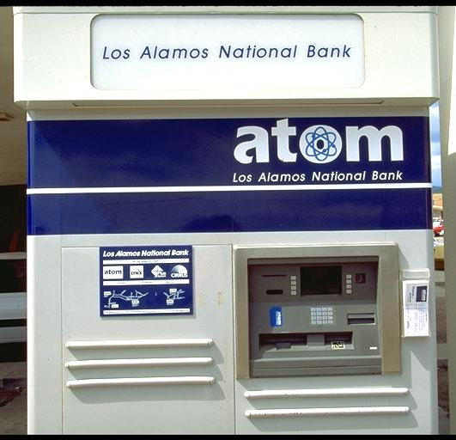
Usability Measures
How can we measure the ‘goodness’ of an interface?
What are good metrics?
ISO 9241
Effectiveness
Efficiency
Satisfaction
Schneiderman
Time to learn
Speed of performance
Rate of errors
Retention over time
Subjective satisfaction

Slide 18
Usability Motivations
Time to learn
Speed of performance
Rate of errors
Retention over time
Subjective satisfaction
Life-Critical systems
Applications: air traffic, nuclear reactors, military, emergency dispatch
Requirements: reliability and effective (even under stress)
Not as important: cost, long training, satisfaction, retention
Industrial and Commercial Use
Applications: banking, insurance, inventory, reservations
Requirements: short training, ease of use/learning, multiple languages, adapt to local cultures, multiplatform, speed
Office, Home, and Entertainment
Applications: E-mail, ATMs, games, education, search engines, cell phones/PDA
Requirements: Ease of learning/use/retention, error rates, satisfaction
Difficulties: cost, size

Slide 19
Usability Motivations
Time to learn
Speed of performance
Rate of errors
Retention over time
Subjective satisfaction
Exploratory, Creative, Collaborative
Applications: Web browsing, search engines, simulations, scientific visualization, CAD, computer graphics, music composition/artist, photo arranger (email photos)
Requirements: remove the ‘computer’ from the experience,
Difficulties: user tech savvy-ness (apply this to application examples)
Socio-technical systems
Applications: health care, voting, police
Requirements: Trust, security, accuracy, veracity, error handling, user tech-savy-ness

Slide 20
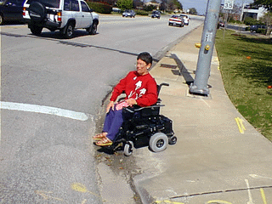
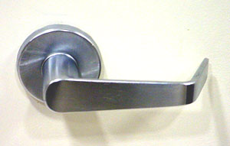
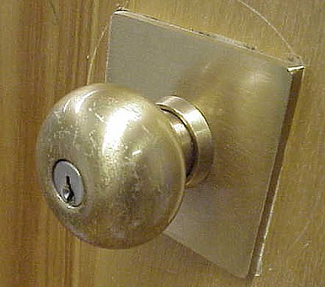
Universal Usability
Interface should handle diversity of users
Backgrounds
Abilities
Motivation
Personalities
Cultures
Question, how would you design an interface to a database differently for:
A. right-handed female, Indian, software engineer, technology savvy, wants rapid interaction
B. left-handed male, French, artist

Slide 21
Universal Usability
Does not mean ‘dumbing down’
Ex. Helping disabled has helped others (parents w/ strollers, elderly)
Ex. Door handles
Goal: Address the needs of more users - unlike yourself!
Everyone is often not at full faculties at all times

Slide 22

Physical Variation
Ability
Disabled (elderly, handicapped, vision, ambidexterity, ability to see in stereo [SUTHERLAND])
Speed
Color deficiency
Workspace (science of ergonomics)
Size
Design
Lots of prior research

Slide 23
Physical Variation
Field of anthropometry
Measures of what is 5-95% for weight, height, etc. (static and dynamic)
Large variance reminds us there is great ‘variety’
Name some devices that this would affect.
note most keyboards are the same
screen brightness varies considerably
chair height, back height, display angle
Multi-modal interfaces
Audio
Touch screens

Slide 24
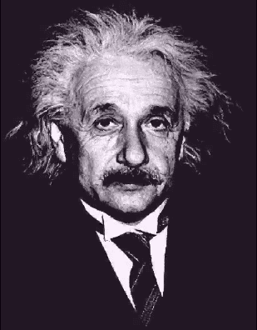
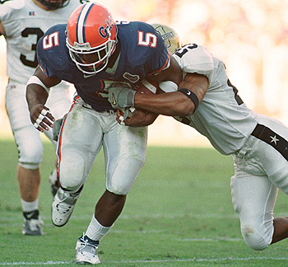
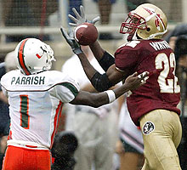
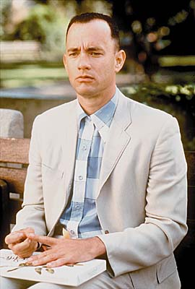
Cognitive and Perceptual Variation
Bloom’s Taxonomy
knowledge, comprehension, analysis, application, synthesis, evaluation
Memory
short-term and working
long-term and semantic
Problem solving and reasoning
Decision making
Language and communication

Slide 25
Cognitive and Perceptual Variation
Language and communication
Search, imagery, sensory memory
Learning, skill development, knowledge acquisition
Confounding factors:
Fatigue
Cognitive load
Background
Boredom
Fear
Drugs/alcohol

Slide 26
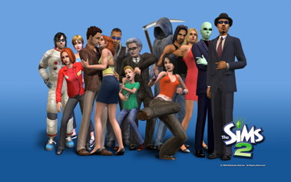
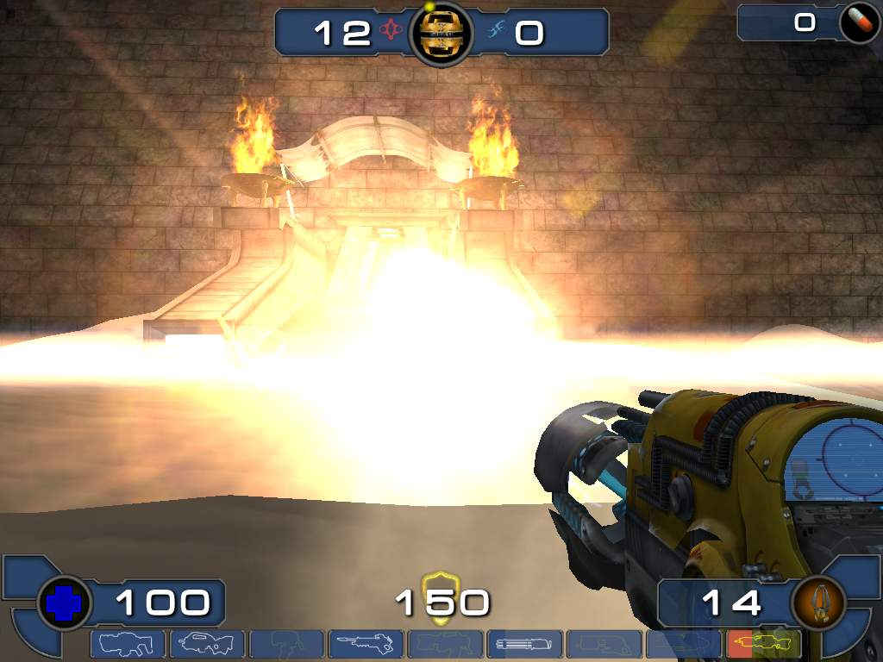
Personality
Computer anxiety
Gender
Which games do women like?
Pac-man, Donkey Kong, Tetris
Why? (Hypotheses: less violent, quieter soundtracks, fully visible playing fields, softer colors, personality, closure/completeness)
Can we measure this?
What current games are for women?
Style, pace, top-down/bottom-up, visual/audio learners, dense vs. sparse data

Slide 27
Personality
No simple taxonomy of user personality types. Ex. Myers-Briggs Type Indicator
Extrovert vs. introvert
Sensing vs. intuition
Perceptive vs. judging
Feeling vs. thinking
Weak link between personality types and interfaces
Think about your application, and see if user personality is important!
Fighter jets vs. search engines

Slide 28
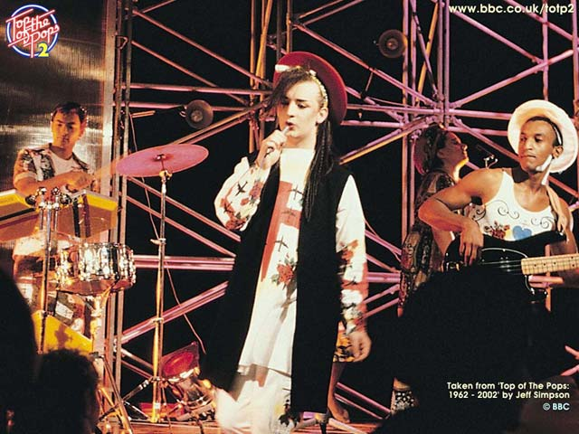
Cultural and International Diversity
Language
Date / Time conventions
Weights and Measures
Left-to-right
Directions (!)
Telephone #s and addresses
Names, titles, salutations
SSN, ID, passport
Sorting
Icons, buttons, colors
Etiquette
Evaluation:
Local experts/usability studies

Slide 29
Users with Disabilities
Federal law to ensure access to IT, including computers and web sites. (1998 Amendment to Rehabilitation Act)
Disabilities
Vision
Blind (bill-reader)
low-vision
color-blind
Hearing
Deaf
Limited hearing
Mobility
Learning
Dyslexia
Attention deficient, hemisphere specific, etc.
Keyboard and mouse alternatives
Color coding
Font-size

Slide 30
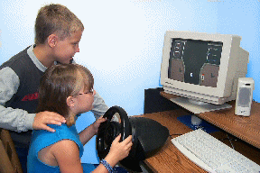
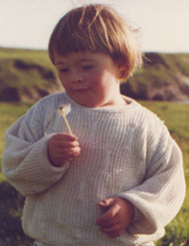
Users with Disabilities
Contrast
Text descriptors for web images
Screen magnification
Text to Speech (TTS) – JAWS (web pages)
Check email on the road, in bright sunshine, riding a bike
Speech Recognition
Head mounted optical mice

Slide 31
Users with Disabilities
Eye Gaze control
Learning what helps those with disabilities affects everyone
Present procedures, directions, and instructions accessible to even poor readers
Design feedback sequences that explain the reason for error and help put users on the right track
Reinforcement techniques with other devices
Good target area for a final project!

Slide 32
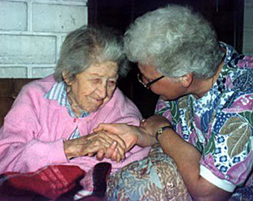
Elderly
Reduced
Motor skills
Perception
Vision, hearing, touch, mobility
Speed
Memory
Other needs
Technology experience is varied (How many grandmothers use email? mothers?)
Uninformed on how technology could help them
Practice skills (hand-eye, problem solving, etc.)
Touch screens, larger fonts, louder sounds

Slide 33
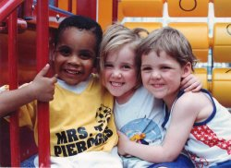
Children
Technology saviness?
Age changes much:
Physical dexterity
(double-clicking, click and drag, and small targets)
Attention span
(vaguely) Intelligence
Varied backgrounds (socio-economic)
Goals
Educational acceleration
Socialization with peers
Psychological - improve self-image, self-confidence
Creativity – art, music, etc. exploration

Slide 34
Children
Teenagers are a special group
Next generation
Beta test new interfaces, trends
Cell phones, text messages, simulations, fantasy games, virtual worlds
Requires Safety
They
Like exploring (easy to reset state)
Don’t mind making mistakes
Like familiar characters and repetition (ever had to babysit a kid with an Ice Age DVD?)
Don’t like patronizing comments, inappropriate humor
Design: Focus groups

Slide 35
Accommodating Hardware and Software Diversity
Support a wide range of hardware and software platforms
Software and hardware evolution
OS, application, browsers, capabilities
backward compatibility is a good goal
Three major technical challenges are:
Producing satisfying and effective Internet interaction (broadband vs. dial-up & wireless)
Enabling web services from large to small (size and resolution)
Support easy maintenance of or automatic conversion to multiple languages

Slide 36
HCI Goals
Influence academic and industrial researchers
Understand a problem and related theory
Hypothesis and testing
Study design (we’ll do this!)
Interpret results
Provide tools, techniques and knowledge for commercial developers
competitive advantage (think ipod)
Raising the computer consciousness of the general public
Reduce computer anxiety (error messages)
Common fears:
I’ll break it
I’ll make a mistake
The computer is smarter than me
HCI contributes to this!

Slide 37
Near & Future Interfaces
Time to learn
Speed of performance
Rate of errors
Retention over time
Subjective satisfaction
Let’s review
Minority Report
Steel Battalion
Eye Toy
Dance Dance Revolution
Nintendo Wii

Slide 38
WELCOME TO THE NEXT LEVEL

Slide 39
HCI ???
What is it?
Who cares?
Why is it hard?
How does it work?
What will I learn?

Slide 40
1. What is HCI?

Slide 41
1. What is HCI?
Human-Computer Interaction

Slide 42
1. What is HCI?
Human-Computer Interaction
Requirements analysis
Design
Development
Evaluation
of user interfaces for computer systems

Slide 43
Huh?
An example:
HomeFinder

Slide 44
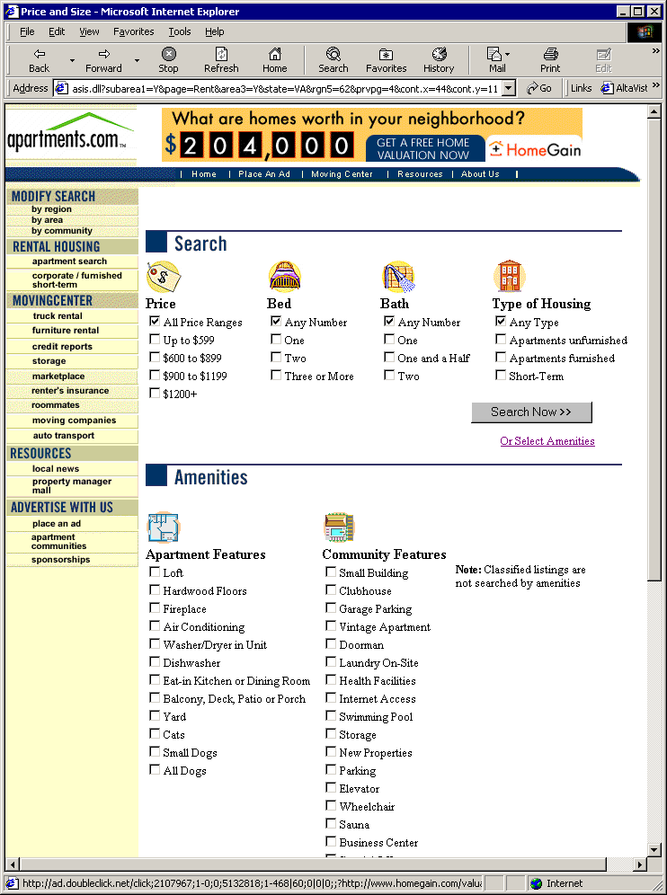
Apartments.com

Slide 45
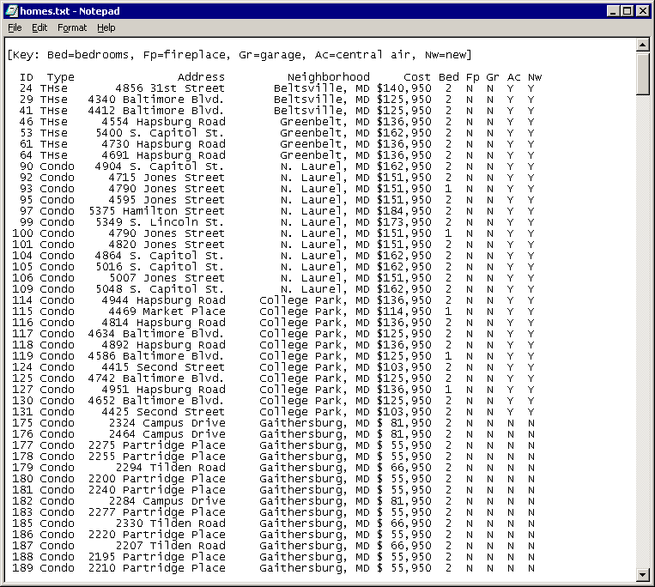
Hit List

Slide 46
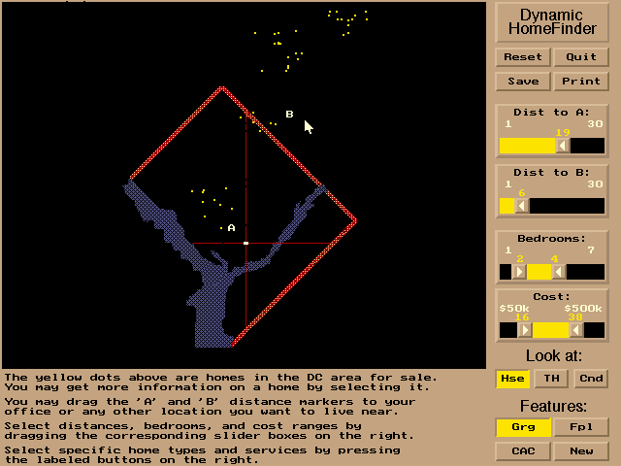
HomeFinder

Slide 47
The Goal of HCI
Usability
People are trying to accomplish their tasks in life. (system independent)
Introduce a system, User Interface should maximize their ability.
task
person
system

Slide 48
2. Who Cares?
Everyone, because:
Everything is a User Interface

Slide 49
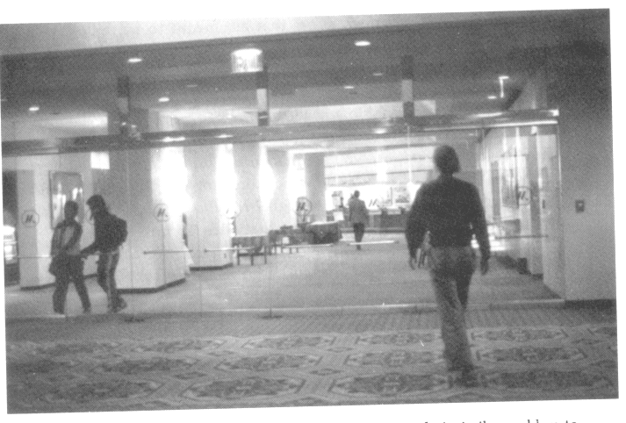
Doors

Slide 50
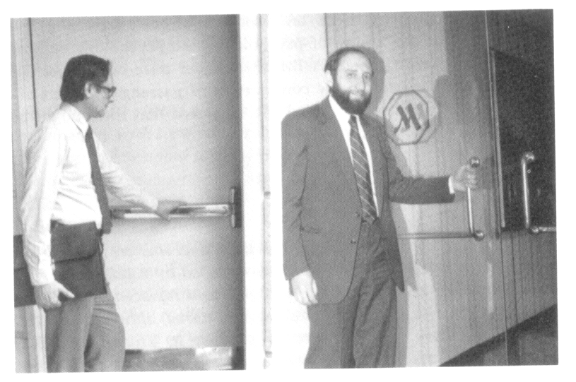
More Doors

Slide 51
Communication Channels
System to human:
Human to system:
system,
world

Slide 52
2. Who Cares?
Everyone, because:
Everything is a User Interface
The User Interface is Everything

Slide 53
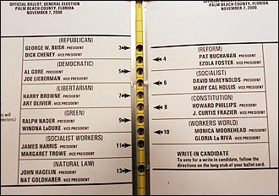
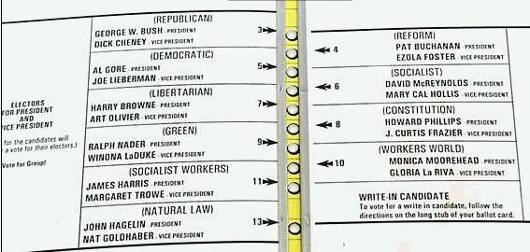
Florida Cares!
Human error: Who’s fault is it?

Slide 54
3. Why is it so hard?

Slide 55
Usability is hard
People (users) are all different
People are unpredictable
Design skill isn’t enough
Evaluation with users is required
Designer’s pride
New ways to think, break out of the box

Slide 56
Usability is hard
People (users) are all different
People are unpredictable
Design skill isn’t enough
Evaluation with users is required
Designer’s pride
New ways to think, break out of the box
Programmers stink at Usability

Slide 57
Usability is hard
Programmers stink at Usability
don’t think like ‘normal’ people
know the software internals, technology first
enjoy systems more than people
arrogant (my software!)

Slide 58
4. How does it work?
Usability Engineering
Reqs Analysis
Evaluate
Design
Develop

Slide 59
4. How does it work?
Usability Engineering
Reqs Analysis
Evaluate
Design
Develop
many iterations

Slide 60
5. What will I learn?
Task analysis
Ethnography
Reqs Analysis
Usability studies
Controlled experiments
Evaluate
Design
Activity design
Information design
Interaction design
Develop
GUI programming
Widgets, graphics, animation
C#

Slide 61
A Method: Scenario-Based Usability Engineering
Stories of people and their activities
Typical elements of the story are:
A setting
One or more actors or agents
An orienting or motivating goal or objective
Mental activity, plans or evaluation of behavior
A “storyline” sequenced by actions and events
Emphasis on use, i.e., people’s needs, expectations, actions, and reactions

Slide 62
ANALYZE
analysis of
stakeholders,
field studies
Problem scenarios
claims about current
practice
Scenario-Based Design
DESIGN
metaphors,
information
technology,
HCI theory,
guidelines
Activity
scenarios
iterative
analysis of
usability
claims and
re-design
Information scenarios
Interaction scenarios
PROTOTYPE & EVALUATE
summative
evaluation
Usability specifications
formative
evaluation

Slide 63
Grander Goals?
Get angry!
Mental shift:
From system-centered design to user-centered design
Break out of the box

